Slide 1
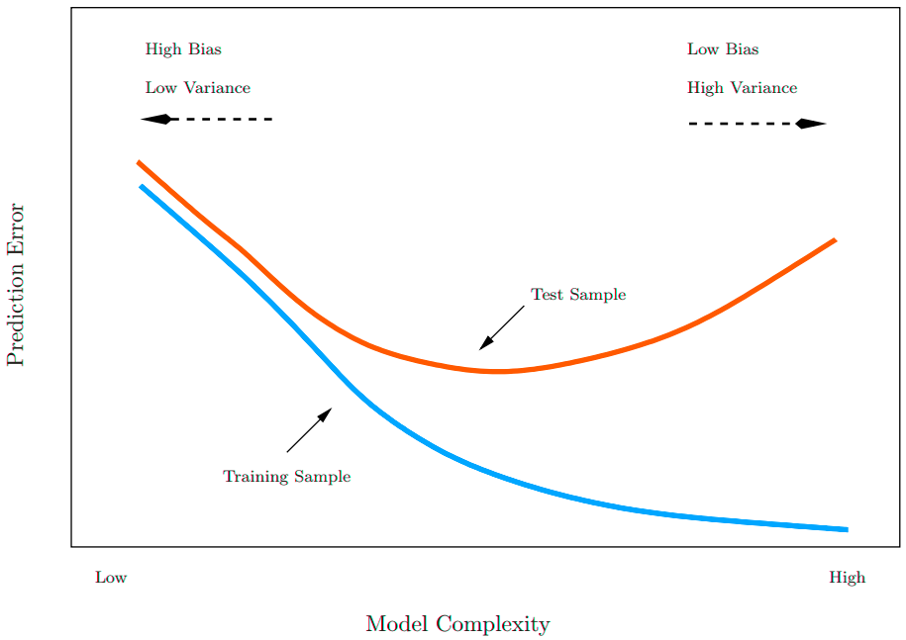
Complexity
Two forms of complexity here:
Mapper Parameter complexity (#_#). Increasing either of these numbers tends to produce more complex mapper structure. Call this param complexity.
Number of mapper objects in committee used to train/test. This number is the same as number of 1D PCA components projected to. Call this component complexity.

Slide 2
Training Accuracy on Real Data (10k)
Max = 90.9% @ 20
Max = 90.2% @ 20
Notes:
- Test accuracy ↑ w/ ↑ component complexity

Slide 3
Training Accuracy on Real Data (10k)
Max = 89.1% @ 20
Max = 84.4% @ 20
Notes:
- Test accuracy ↓ w/ ↑ param complexity @ 20

Slide 4
Test Accuracy on Real Data (10k)
Max = 29.5% @ 1, 30.0% @ 4
Max = 82% @ 8
Notes:
- Increasing component complexity doesn’t help for anything other than 10_10 - 10_10 w/ 8 components seems to be the magic combo

Slide 5
Test Accuracy on Real Data (10k)
Max = 30.8% @ 1
Max = 35% @ 1
Notes:
- There are consistently a few peaks, notably around 6 components

Slide 6
Train on 30k real, test on 10k real
Train Max = 93% @ 20 Test Max = 87% @ 8
Notes:
Increasing the training size increased test accuracy by 5%
At components 6, 7, & 8 the test accuracy ~ training accuracy.

Slide 7
Test Accuracy on Adversarial Data (10k) *Adversarial produced from test set
Notes:
- 10_10 w/ 8 components consistent with training accuracy
Max = 77.4% @ 8

Slide 8
Test Accuracy on Adversarial Data (10k) *Adversarial produced from training set
Notes:
At components 6, 7, & 8 the test accuracy ~ OOB accuracy.
OOB Max = 90.6% @ 20 Test Max = 87.6% @ 8

Slide 9
Summary of Results
Train Set | OOB Accuracy (%) | Test Set | Test Accuracy (%)
10k Real | 90 | 10k Adversarial (From train set) | 88
10k Real | 90 | 10k Real | 82
10k Real | 90 | 10k Adversarial (From test set) | 77
30k Real | 93 | 10k Real | 87
60k Real | 94.5 | 10k Real | 94.5
Checks
10_10 c8 is consistently best
Test on adversarial data that pymapper trained on is highest = good
Increasing train set increases test accuracy
Questions
How to boost
What to do for preprocessing data
Shape of training accuracy
What is adversarial to our setup
Notes
OOB Accuracy not training accuracy
Non-IID probably explain some weirdness
Splitting procedure done for 60k. Test accuracy given for PCA20 (seems like splitting procedure removes IID issues)
Notes:
PCA & mapper constructions "bakes” in global structure to each data point. This structure can be resolved (which will improve OOB accuracy) by adding more components. Resolving the structure is the same as learning the correlations between the strings of 0’s and 1’s in the mapper. These correlations are specific to the global structure (i.e. the train data set chosen). If multiple train datasets are used, you can “untrain” your algorithm so these correlations are harder to learn.
Increasing the overall parameter complexity, while still baking in the global structure, increases the complexity of the global structure captured by the mapper. Thus, learning correlations between 0’s & 1’s is harder. This may explain why @ 20PCA, the OOB score goes down. However, I suspect that the max OOB score will still go up with increasing parameter complexity, so long as enough PCAs are added (i.e. so the algorithm can learn the global structure). For instance, higher param complexity may have stabilized OOB score = 95% @ 100PCA whereas lower param complexity may have stabilized OOB score = 93% @ 80PCA.

